Slide 1

UE20CS302 – Machine Intelligence
Mini Project
Traffic Sign Classification
Team No: 20
Project Guide : Prof. Kokila
Project Team with SRNs :
Aishwarya B PES2UG20CS491
Ashwathy S Kumar PES2UG20CS496
D Nisha PES2UG20CS506

Slide 2
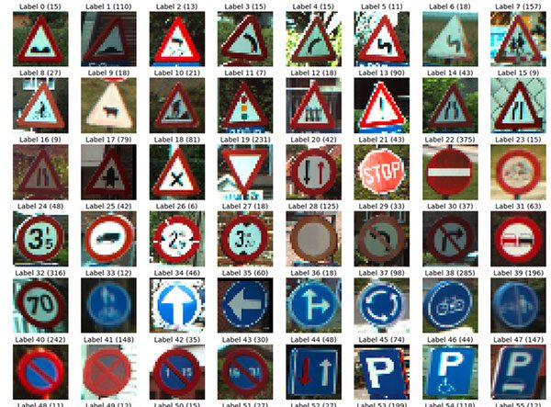
Problem Statement
Traffic sign classification is the process of automatically recognizing the traffic signs along the road, including speed limit signs, stop signs, merge signs , etc. Being able to automatically recognize traffic signs enables us to build smarter cars.
This problem has two aspects, first is feature extraction i.e., extracting relevant features from the traffic sign images and second is image classification, which includes classification of an image to its corresponding class based on the extracted features.
To solve this problem, we are using “Deep Learning”, specifically “Convolutional Neural Network (CNN)”.

Slide 3
Application and Uses
Can be used in autonomous vehicles.
Help the driver to recognise the traffic sign under abnormal conditions. For example if the driver is new to the place (let's say some foreign country) where he/she wants to drive, but is unaware of the traffic signs in that country.
It can also be used under extreme weather conditions. For example, it’s very hard to see the traffic signs on the road at the time of heavy rainfall. At those times traffic sign classifier plays a significant role.

Slide 4
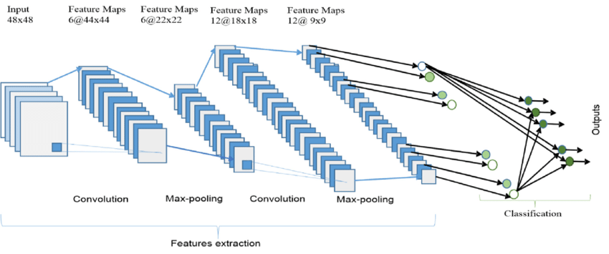
High level Architecture

Slide 5
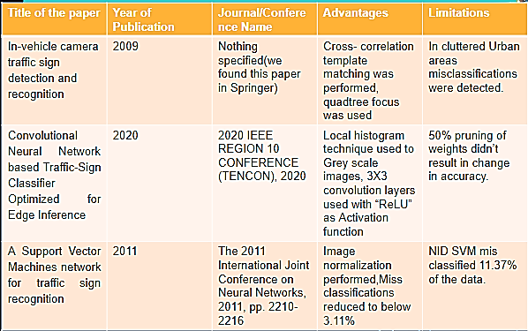
Literature Survey

Slide 6
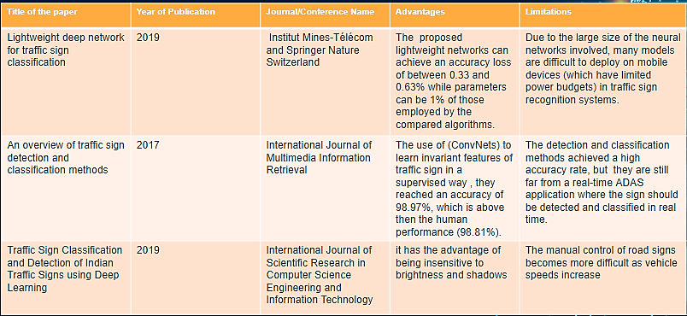
Literature Survey

Slide 7
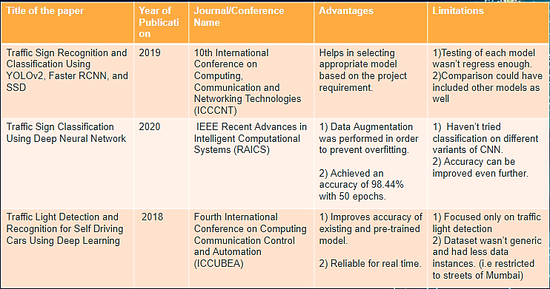
Literature Survey

Slide 8
Proposed Approach
We have used many convolution layers with dense layers and dropdowns to get desired results(i.e. Accuracy of 94%).
The user uploads an image containing German traffic sign into the front end for the trained model to classify it amongst the predetermined classes only.
The model is expected to classify the image 94 % of the time correctly as we have trained out model for 20 epochs to obtain the results.

Slide 9
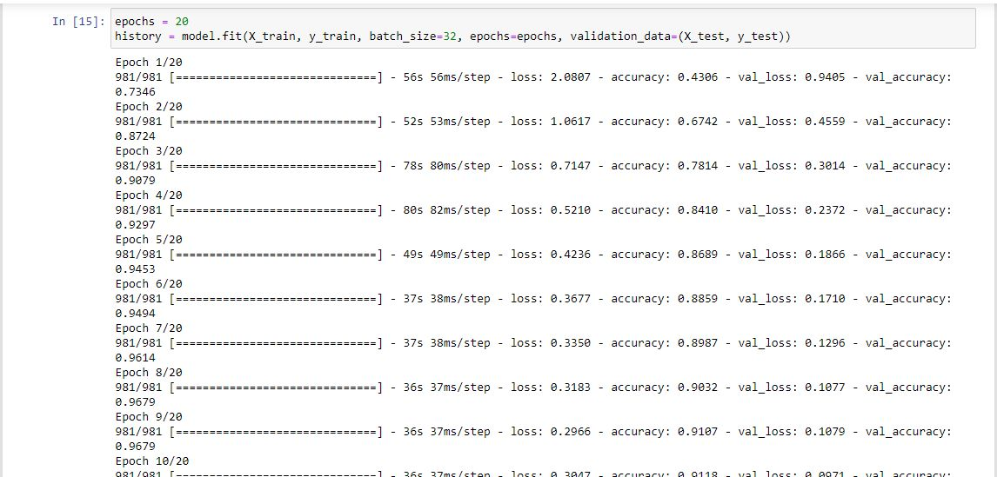
Results and Discussion
CMD output while training model

Slide 10
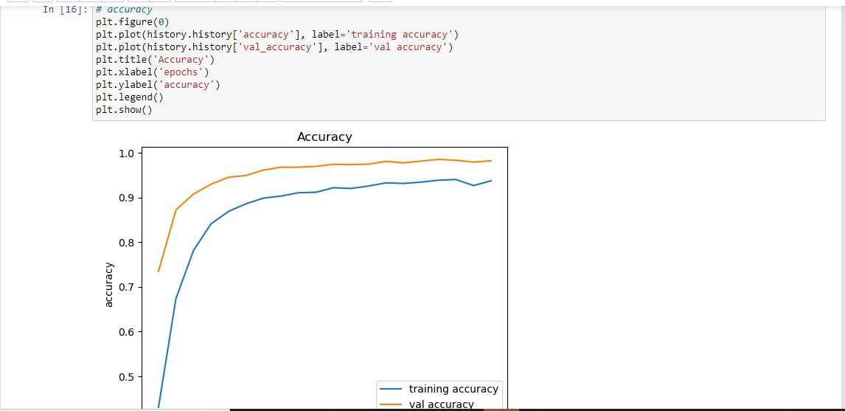
Results and Discussion
Plotted while testing the model:(Accuracy Vs Epoch)

Slide 11
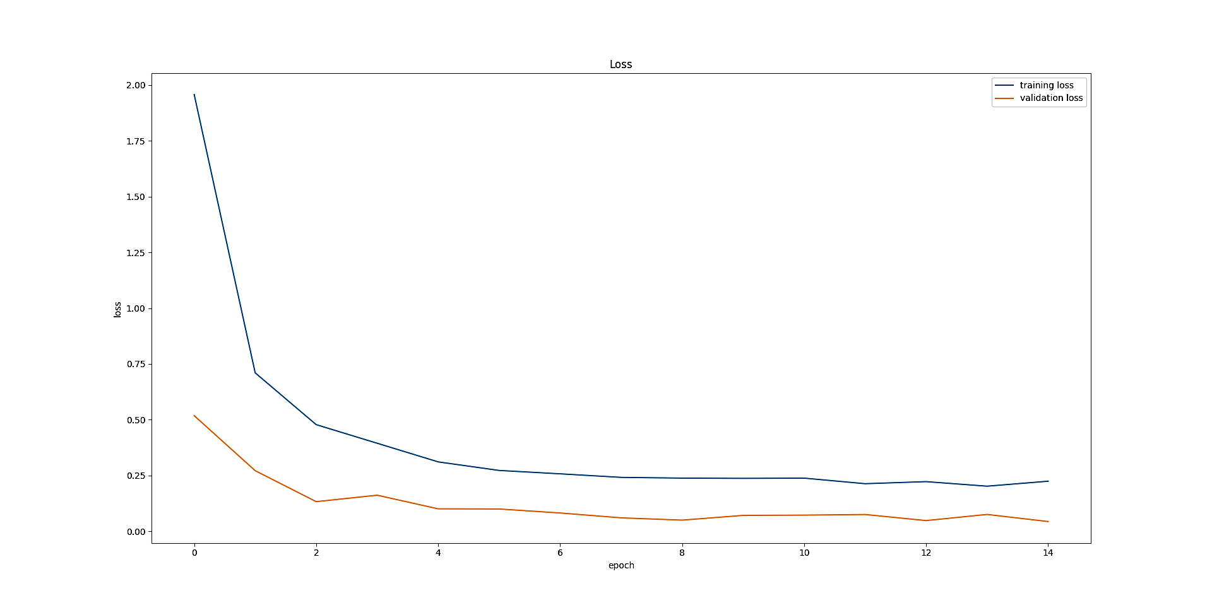
Results and Discussion
Plotted while testing the model:(Loss Vs Epoch)

Slide 12
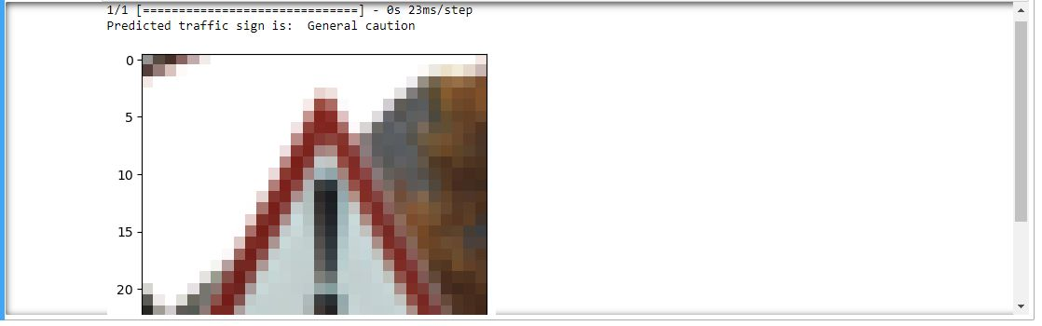
output

Slide 13
Conclusion
We have tested our model thoroughly and concluded that it can predict 98% of the time correctly provided the traffic sign belongs to german data set. If not the model still classifies but not with the abovementioned accuracy.
The future scope is to implement the same using openCV library that would enable it to give live predictions with more accuracy.

Slide 14
References
F. Boi and L. Gagliardini, "A Support Vector Machines network for traffic sign recognition," The 2011 International Joint Conference on Neural Networks, 2011, pp. 22102216, doi: 10.1109/IJCNN.2011.6033503.
B. Shabarinath and P. Muralidhar, "Convolutional Neural Network based Traffic-Sign Classifier Optimized for Edge Inference," 2020 IEEE REGION 10 CONFERENCE (TENCON), 2020, pp. 420-425, DOI: 10.1109/TENCON50793.2020.9293767.
S. Song, Z. Que, J. Hou, S. Du and Y. Song, "An efficient convolutional neural network for small traffic sign detection“
P. Garg, D. R. Chowdhury and V. N. More, "Traffic Sign Recognition and Classification Using YOLOv2, Faster RCNN and SSD," 2019 10th International Conference on Computing, Communication and Networking Technologies (ICCCNT), 2019, pp. 1-5, doi: 10.1109/ICCCNT45670.2019.8944491.
M. A. Vincent, V. K. R and S. P. Mathew, "Traffic Sign Classification Using Deep Neural Network," 2020 IEEE Recent Advances in Intelligent Computational Systems (RAICS), 2020, pp. 13-17, doi: 10.1109/RAICS51191.2020.9332474.
Vennelakanti, S. Shreya, R. Rajendran, D. Sarkar, D. Muddegowda and P. Hanagal, "Traffic Sign Detection and Recognition using a CNN Ensemble," 2019 IEEE International Conference on Consumer Electronics (ICCE), 2019, pp. 1-4.
Traffic Sign Classification and Detection of Indian Traffic Signs using Deep Learning Manjiri Bichkar, Suyasha Bobhate, Prof. Sonal Chaudhari, doi: https://doi.org/10.32628/CSEIT217325 215 .
W. Haque, S. Arefin, A. Shihavuddin and M. Hasan, " lightweight CNN architecture for traffic sign recognition without GPU requirements", Expert Systems with Applications, vol. 168, p. 114481, 2021.
Lightweight deep network for traffic sign classification Jianming Zhang1,2 & Wei Wang1,2 & Chaoquan Lu1,2 & Jin Wang1,2 & Arun Kumar Sangaiah3 Received: 15 December 2018 /Accepted: 18 July 2019 # Institut Mines-Télécom and Springer Nature Switzerland AG 2019

Slide 15
Thank You

